Slide 1
Deep Learning_25주차
Department of Data Science
Hyun seok Lee

Slide 2
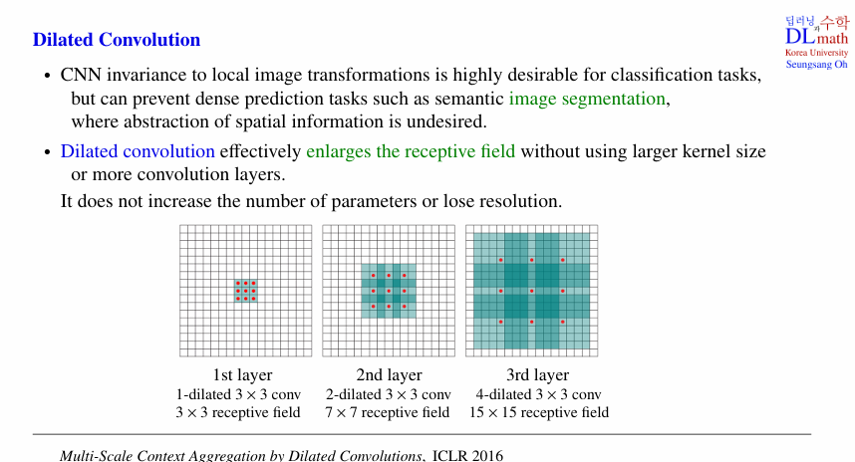
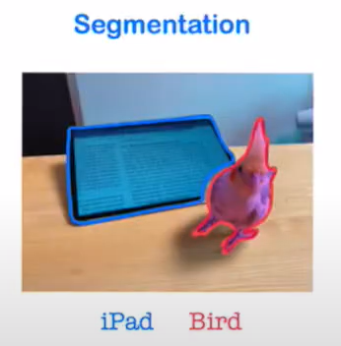
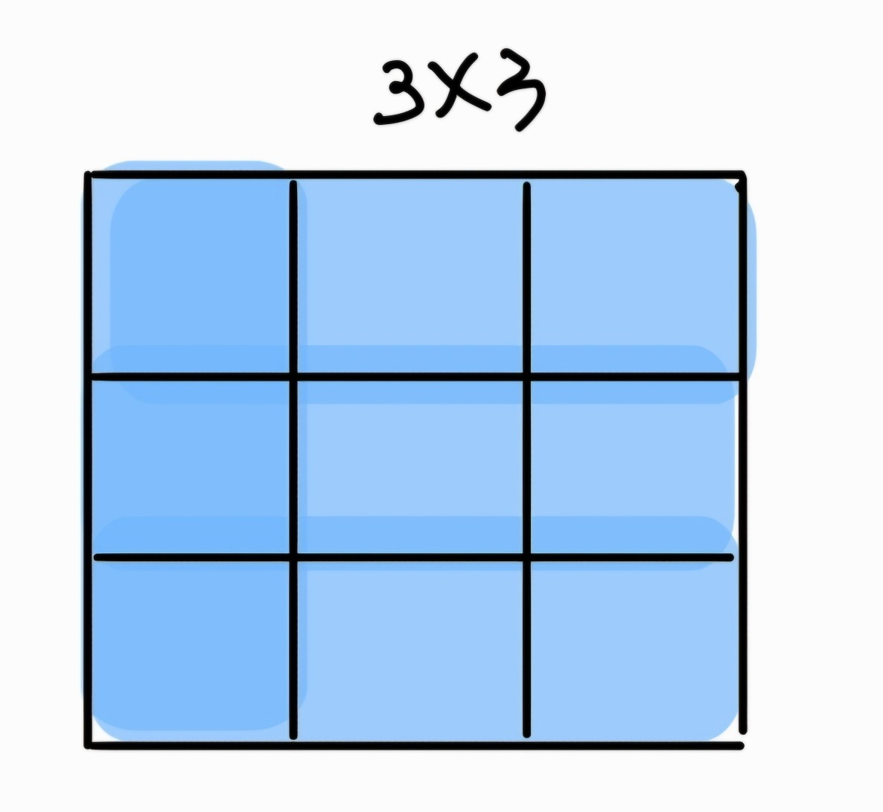
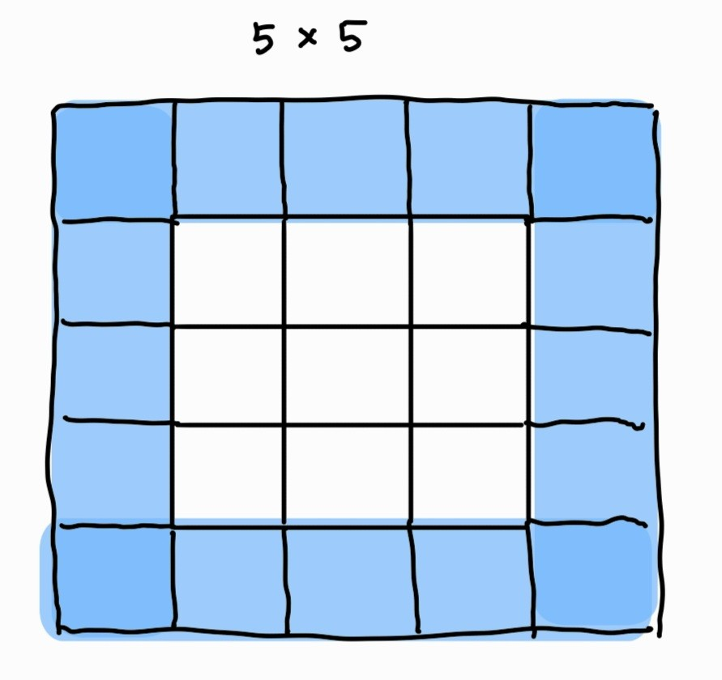
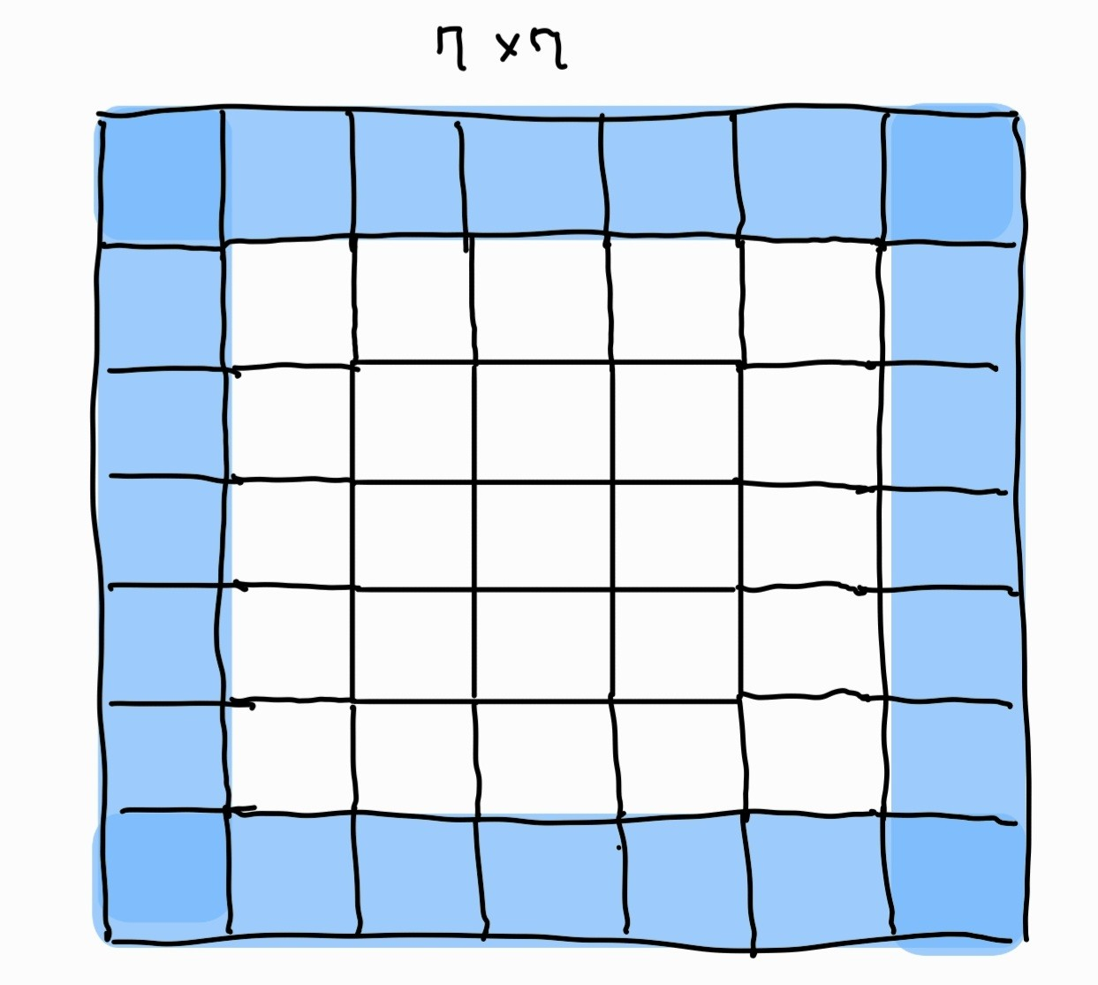
1. Dilated convolution
Classification vs. Image sementation
Dilated 되지 않은 일반적인 1st, 2nd, 3rd layer

Slide 3
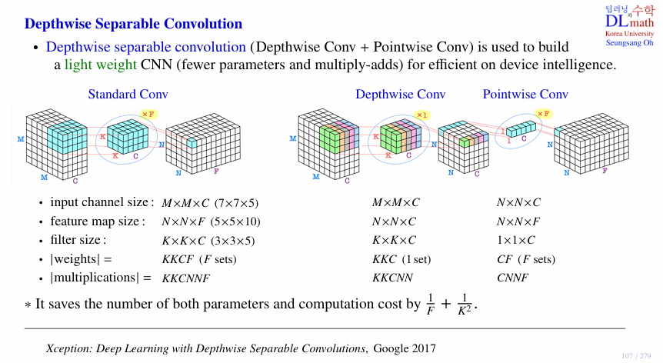
Depthwise Separable Convolution

Slide 4
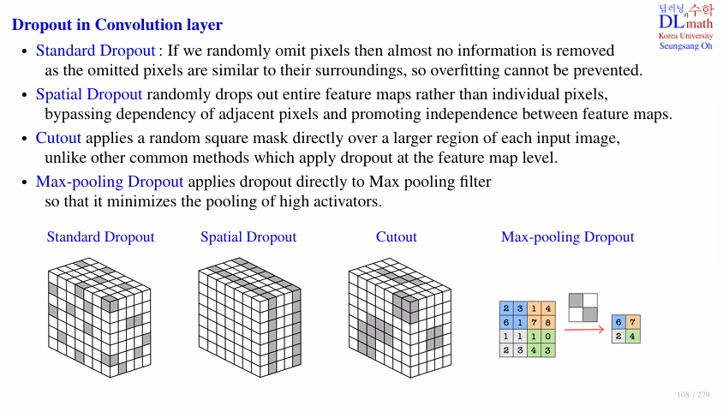
Dropout in Convolution layer

Slide 5
감사합니다
Thank you

